Slide 1
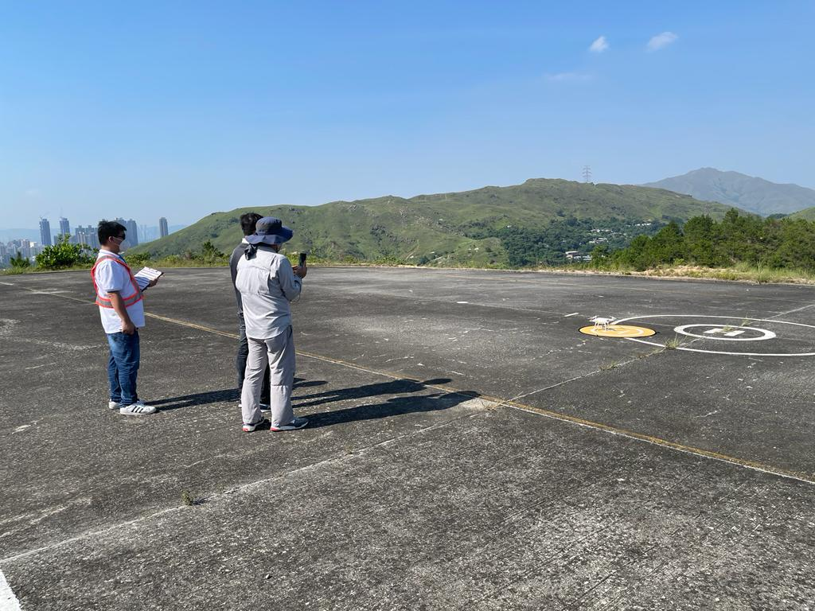
RTTP fund
ITF subsidises local
companies 2/3 course fee
Course schedule:
3 days Theory course:
18, 19 & 25 Mar 2023
2 days Flight training & FOA:
13, 27 Apr 2023
Application deadline:
11 Mar 2023
Coming class: 18 Mar 2023
Course fee: $9750
SUA Advanced Rating Training Course
Program highlight:
Recongzied by HKCAD
IAM provides UK CDP-C since 2018
Trained over 500 qualified SUA pilot in HK
Experience and Professional Instructors and trainers
Online learning platform for exam preparation
English handbooks with English and Chinese Instruction
Part A: Ground School
Air legislation and publications
Airspace in Hong Kong
Navigation and units of measurement
SUA general knowledge
Meteorology
Airmanship and human factors
Operation Manuel, flight planning and procedures
Theory Examination
Part B: Flight Training
Pre-flight Procedure
Required Flight Procedure
Flight Operations Assessment (FOA)
Enquire
28383882
60920819
Online Reg.
www.iam.org.hk
sua.admin@iam.org.hk
8/F, Morrision Plaza, 9 Morrison Hill Rd, Wanchai

